Slide 1
UK-ACCIDENT DATASET ANALYSIS
Haichuan Zhao & Lixin Li
2024-04-09

Slide 2
Outline
Data – Lixin
EDA
ERD
ETL
SQL – Haichuan
SELECT
VIEW
CTE
Materialized view
Graphical Methods
Index and without

Slide 3
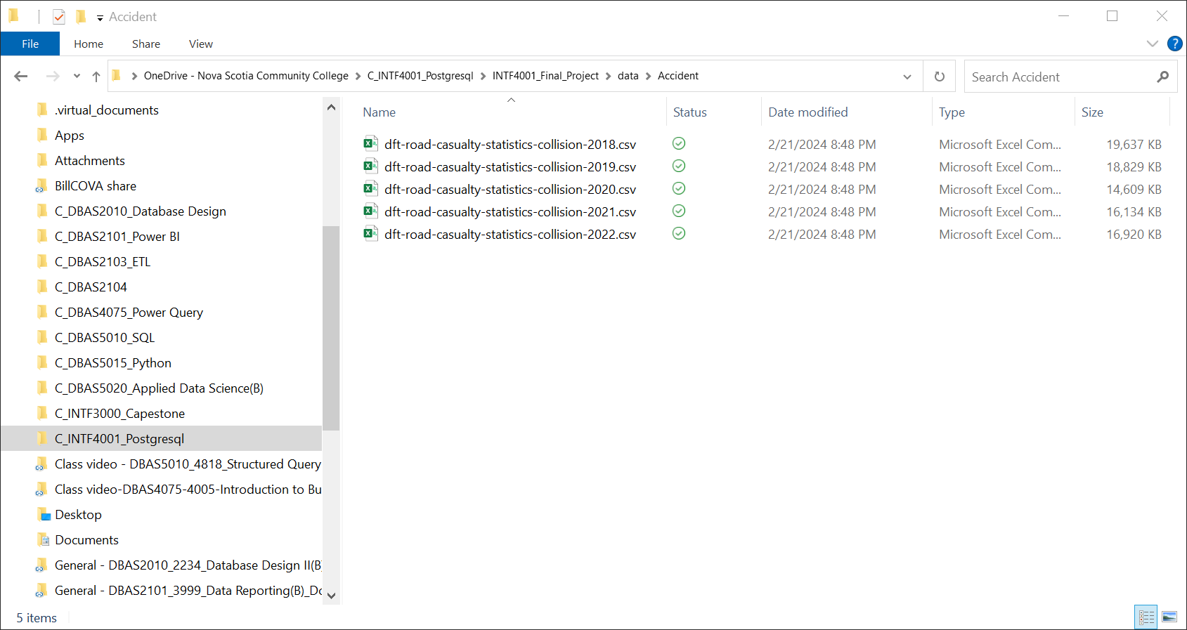


Data - EDA

Slide 4
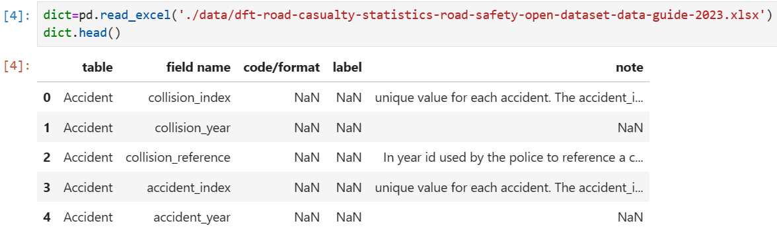
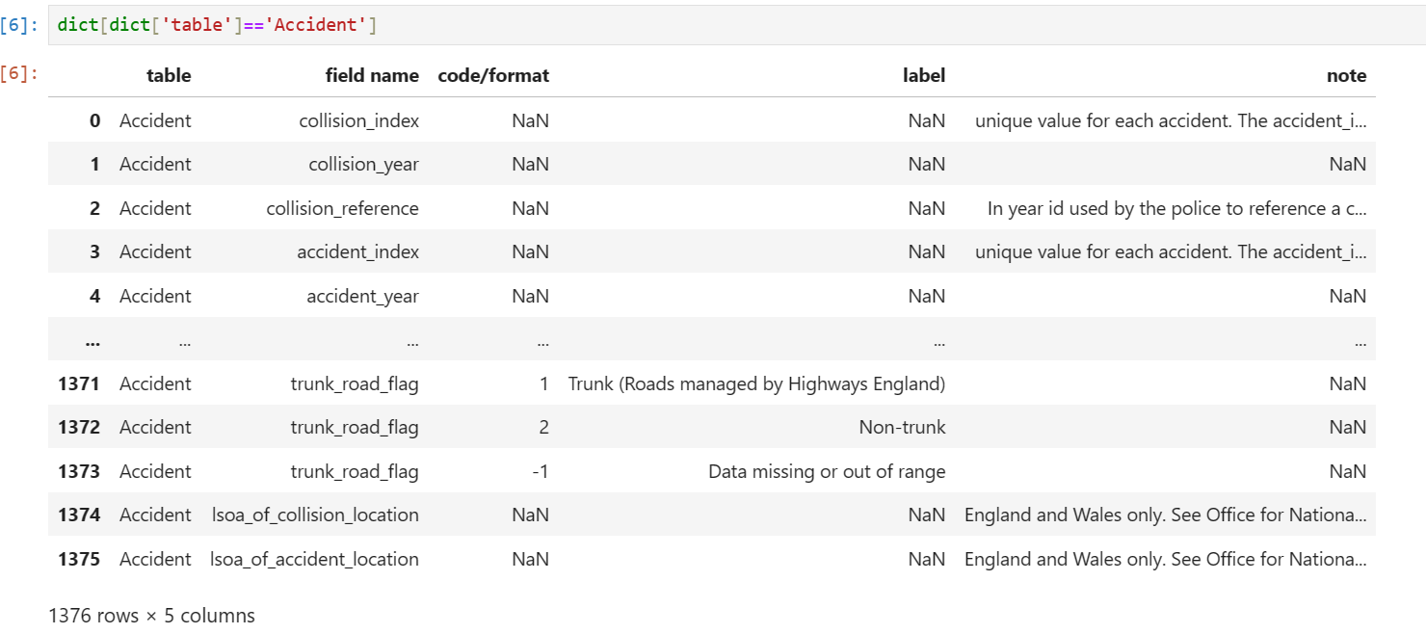
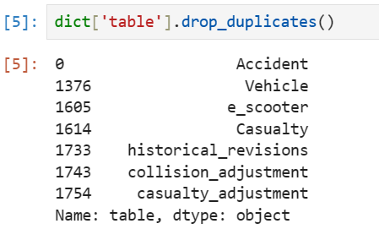
Data - EDA

Slide 5




Data – EDA

Slide 6
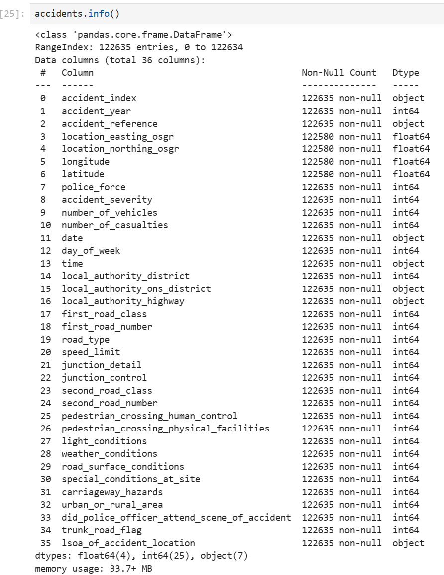
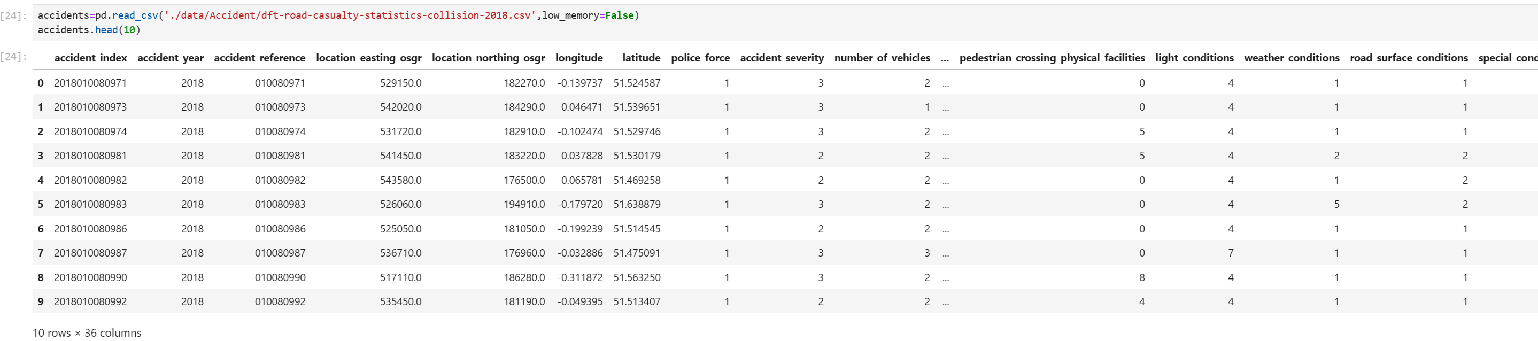
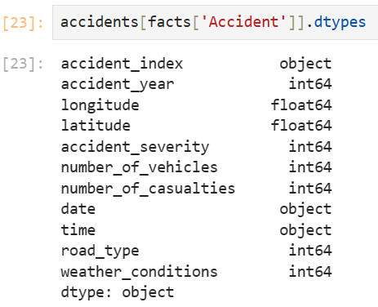
Data - EDA

Slide 7
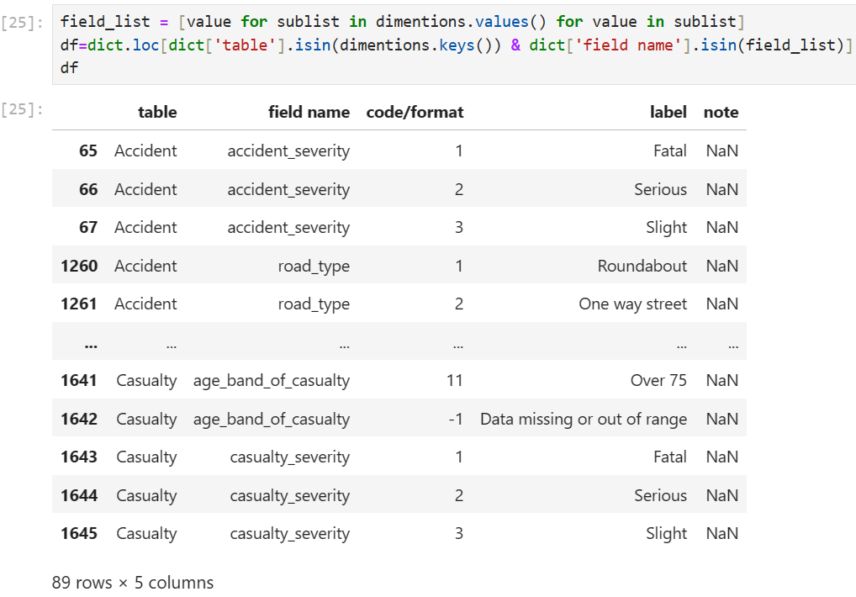
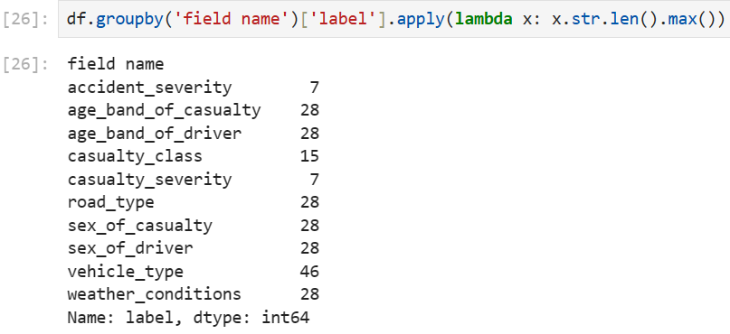
Data - EDA

Slide 8
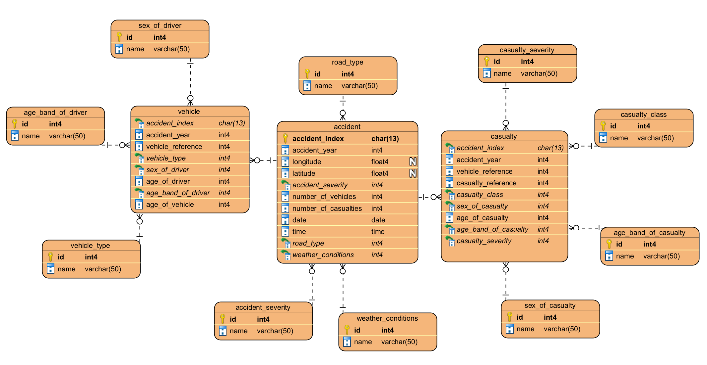
Data - ERD

Slide 9
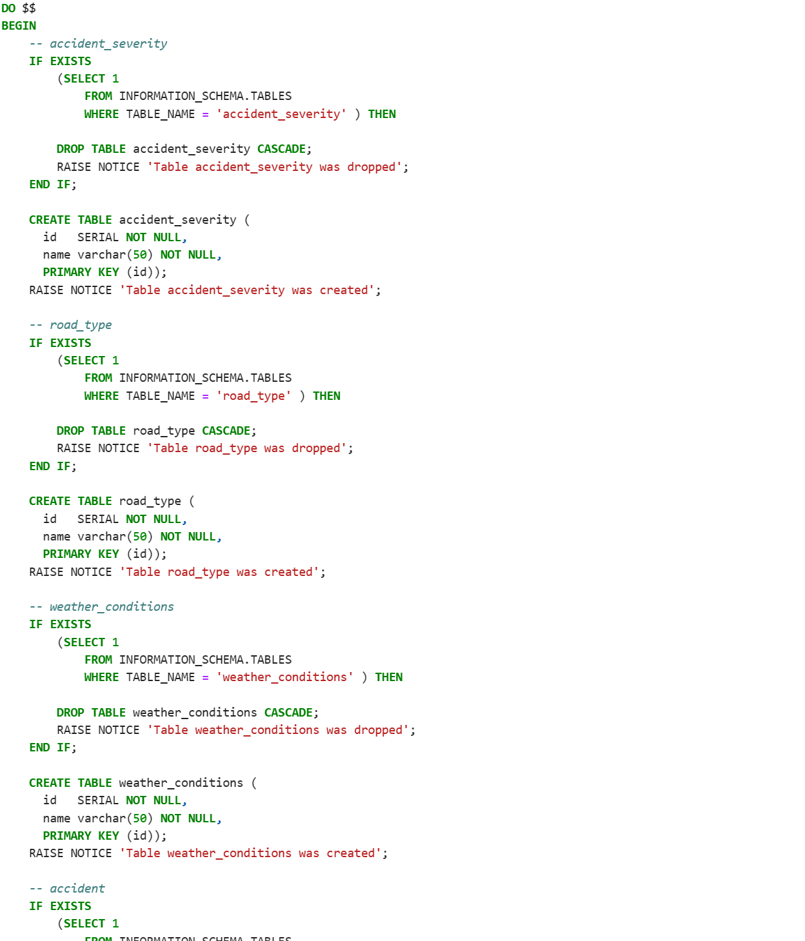
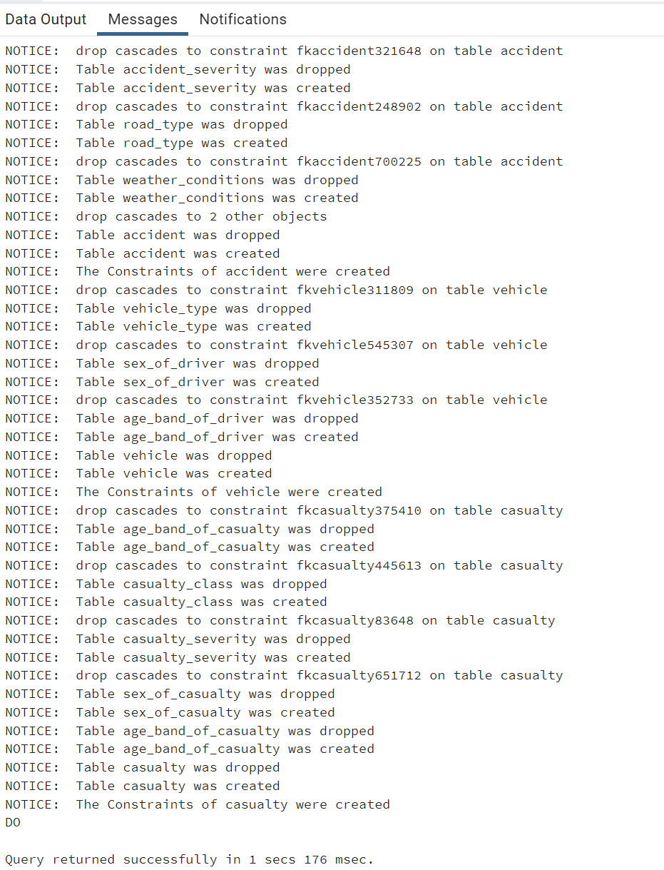
Data - ERD

Slide 10
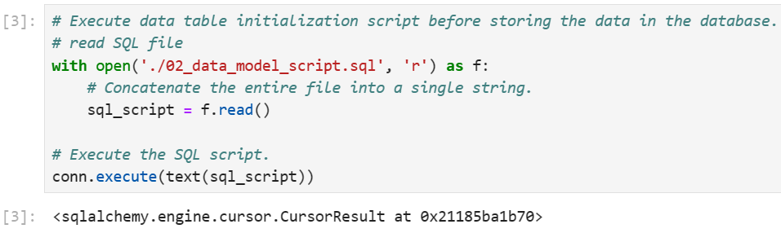
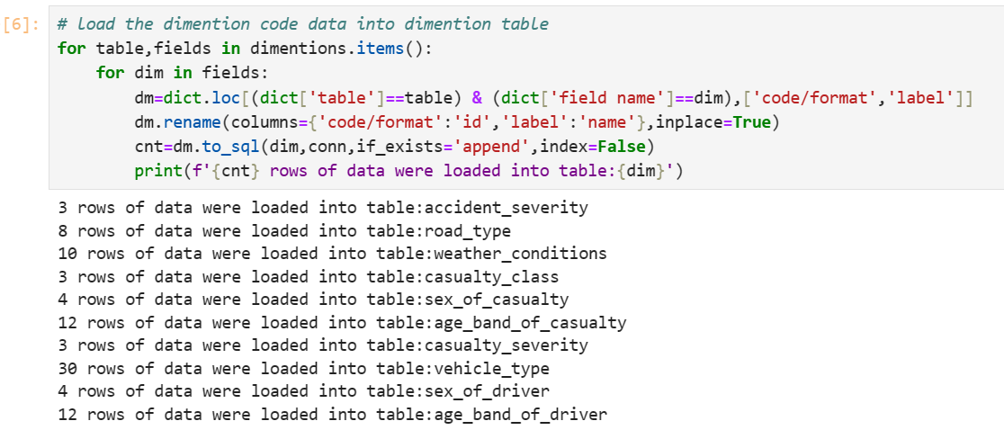
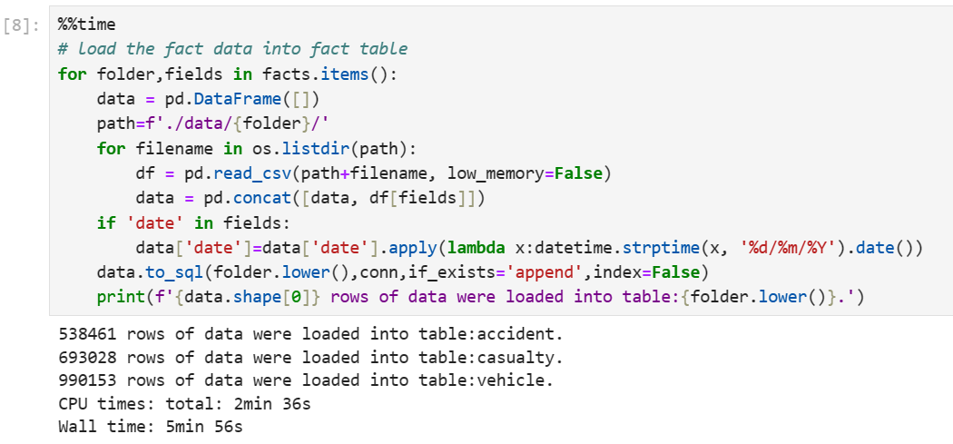
Data - ETL

Slide 11
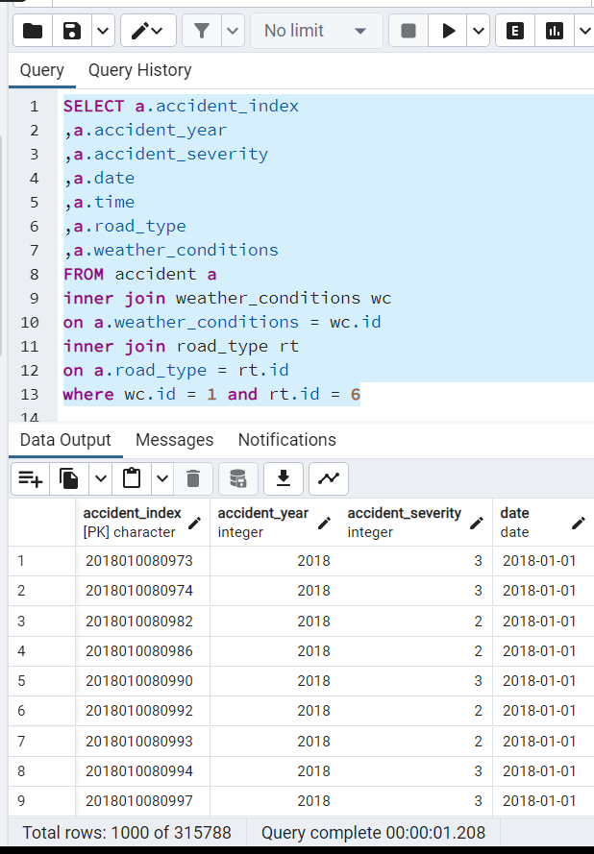
SELECT STAMENT

Slide 12
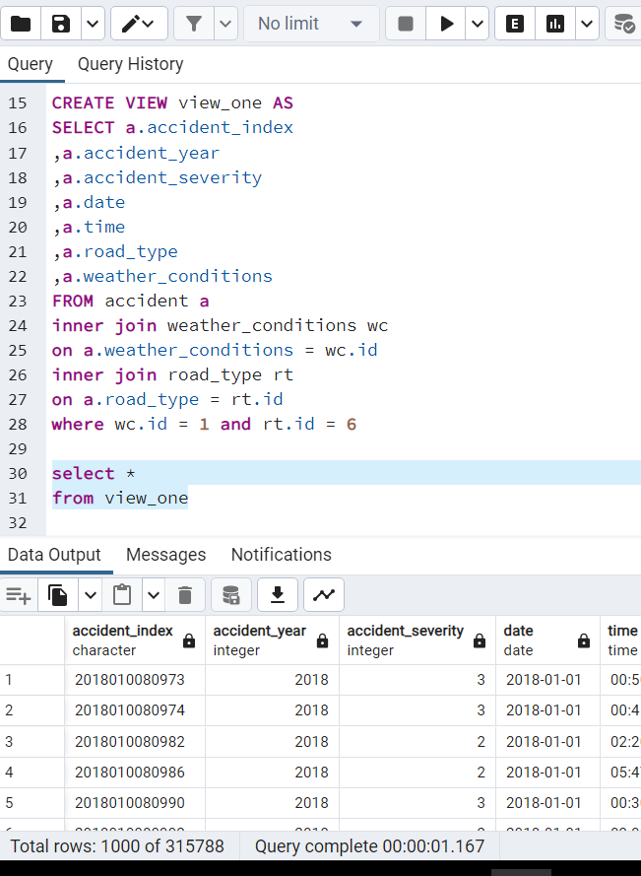
View statement

Slide 13
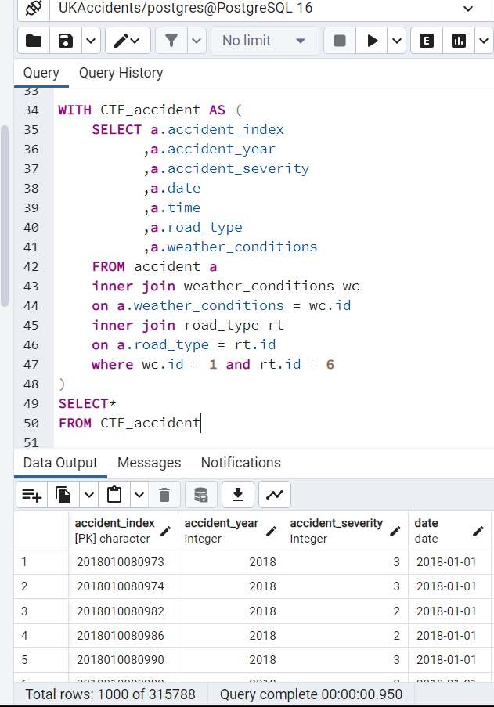
CTE

Slide 14
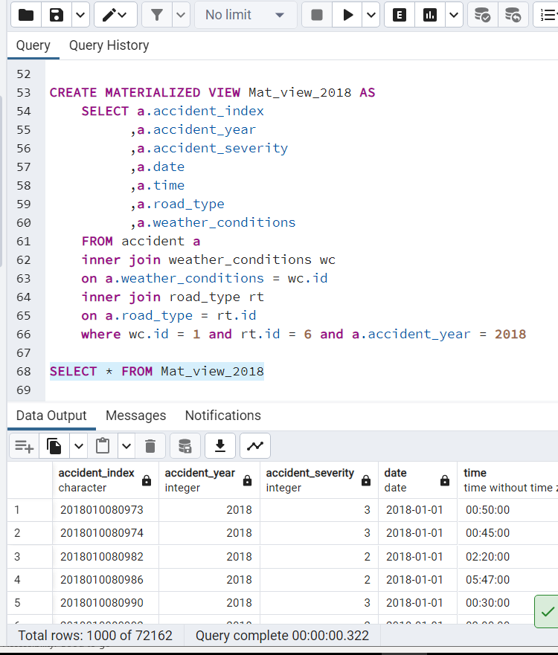
Materialized view2018

Slide 15
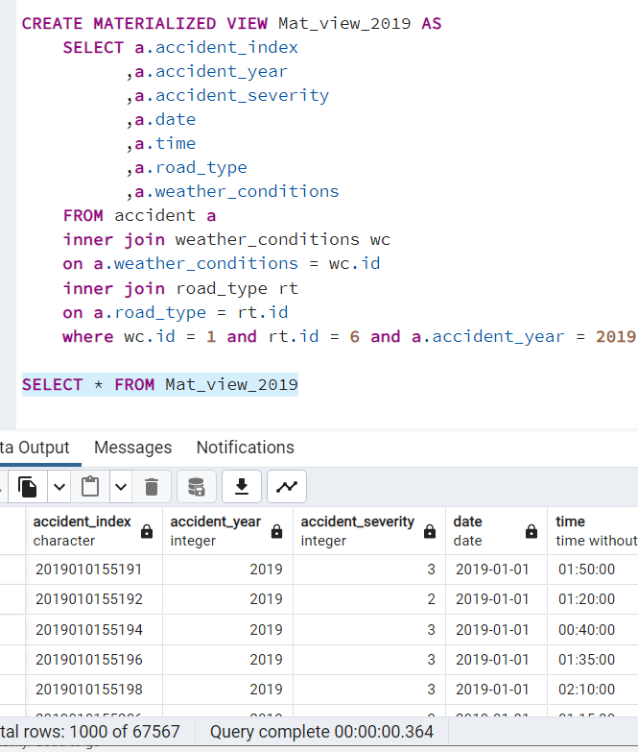
Materialized view2019

Slide 16
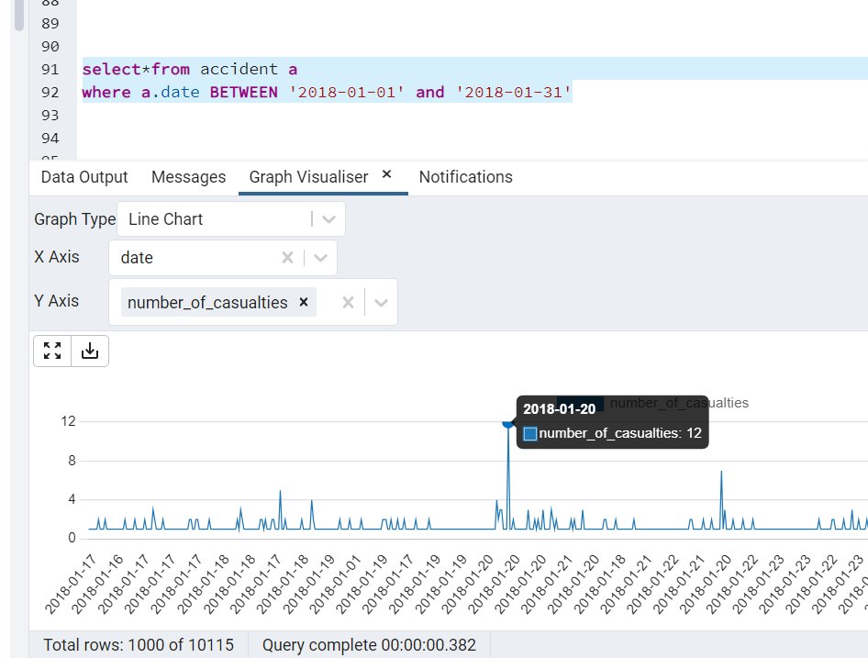
Graphical Methods
In this case, I wanted to chase the number of casualties for the entire month of January 2018. Looking through the charts, I see that the highest point of casualties was January 20, 2018, when the number of casualties was at 12 people.

Slide 17
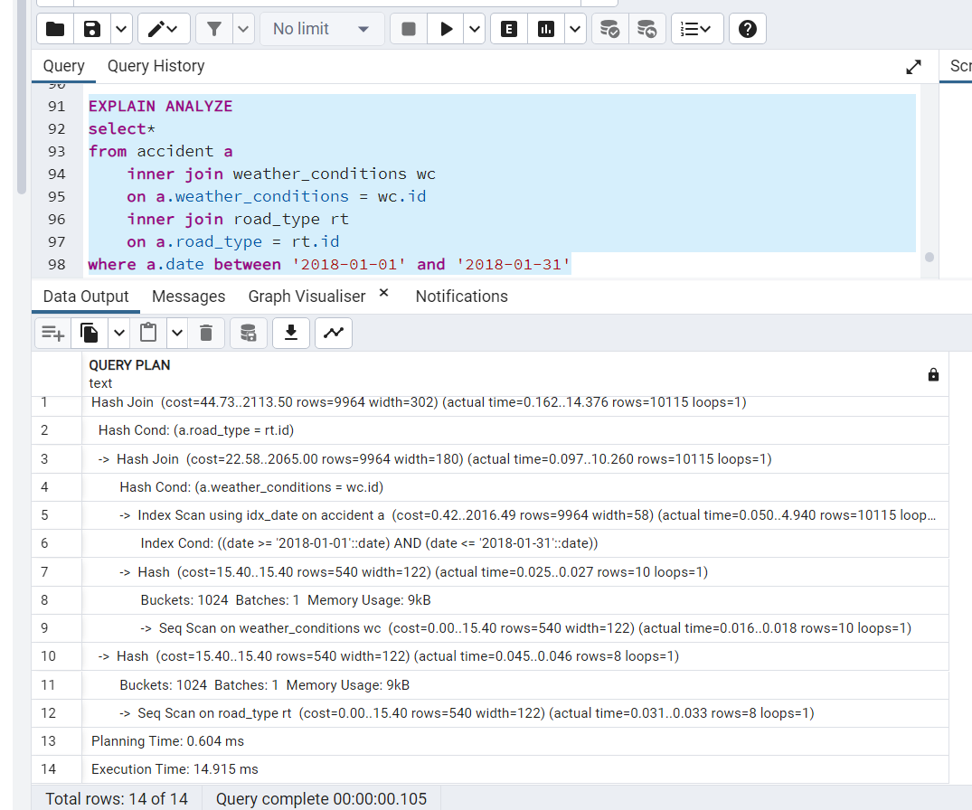
Index
When I set up index on accident table date column, we can see the actual time = 0.162
The Execution Time is 14.915ms

Slide 18
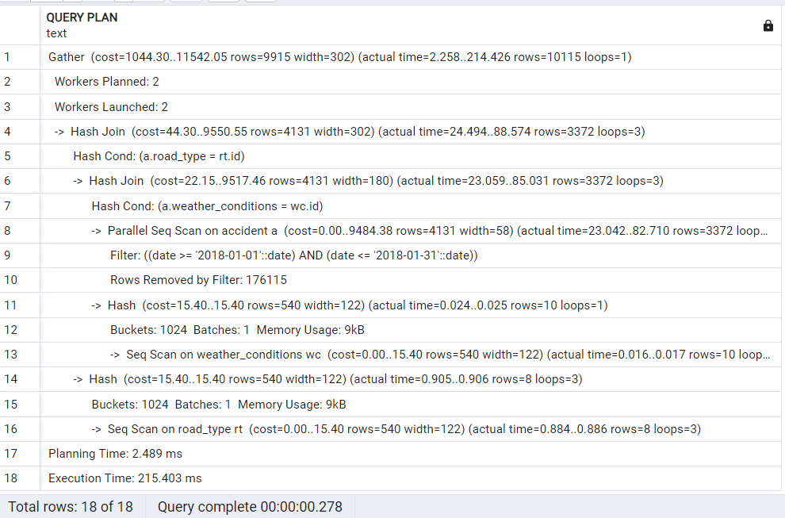
Without Index
After I drop index on accident table date column, we can see the actual time = 2.258
The Execution Time is 215.403ms
Notes:
After comparing, This means that adding an index can make your work more efficient hundreds of times if in a very large dataset.

Slide 19
Reference
Road Safety Data - data.gov.uk
https://www.data.gov.uk/dataset/cb7ae6f0-4be6-4935-9277-47e5ce24a11f/road-safety-data

Slide 20

Thank you
GitHub：
https://github.com/lixinli0936/INTF4001_Final_Project

